Slide 1
Summarizing Online Reviews Ecommerce Data Mining using Machine Learning

Slide 2
Roadmap
Introduction
Related Work
Proposed Methodology
Designed Experimentation and Evaluation
Discussion and conclusion
References

Slide 3
Introduction

Slide 4
Our Motivation
Analysis 2022
Over 2.14 billion people bought goods and services online
E-commerce sales reached $4.9 trillion
Notes:
A solution that can help both businesses and consumers to better understand and utilize the valuable insights contained in user-generated content

Slide 5
Problem statement
Problem
The increasing volume of reviews make it difficult to navigate through all
Solution
utomatically summarAizing reviews

Slide 6
Related Work

Slide 7
Related Work
Source | Keywords | Methodology | Datasets
"Knowledge graph summarization impacts on movie recommendations", 2022 Juarez A. P. Sacenti, Renato Fileto, Roberto Willrich | Recommender systems, Knowledge graphs, Graph summarization, Entity clustering, Knowledge graph embedding, Multi-view clustering | Proposed a Graph Summarization (GS) method that utilizes latent semantics (ComplEx) embedding and node clustering (K-Means) for Knowledge Graph (KG) summarization to reduce computational costs | MovieLens 1M dataset
"Study of automatic text summarization approaches in different languages", 2021 Yogesh Kumar, Komalpreet Kaur, Sukhpreet Kaur | Text summarization, Machine learning, Feature extraction, Classifications, Natural language processing | Provides a concise view of various feature extraction methods and classification techniques required for different types of text summarization approaches applied to both Indian and non-Indian languages | 50 News documents (Punjabi), 50 Random Tamil documents, 634 News articles (Marathi), Online Malayalam news sources

Slide 8
Related Work
Source | Keywords | Methodology | Datasets
"Hybrid recommendation by incorporating the sentiment of product reviews", 2021 Mehdi Elahi, Danial Khosh Kholgh, Mohammad Sina Kiarostami, Mourad Oussalah, Sorush Saghari | Recommender systems, Sentiment analysis, Content-based recommendation | Proposed a novel form of a hybrid recommender system that has the ability to analyze reviews and extract their sentiments for integration into the recommendation process. | Amazon Digital Music and Amazon Video Games
"Summarizing Online Movie Reviews: A Machine Learning Approach to Big Data Analytics", 2020 Atif Khan, Muhammad Adnan Gul, M. Irfan Uddin, Syed Atif Ali Shah, Shafiq Ahmad, Muhammad Dzulqarnain Al Firdausi, and Mazen Zaindin | Machine Learning, summarization, POS tagging | Proposed an approach that combines both supervised and unsupervised learning to categorize the reviews as positive or negative and then summarize (condense) the categorized reviews in the domain of movie review. | Polarity dataset v2.0, IMDB dataset

Slide 9
Related Work (Contd.)
Source | Keywords | Methodology | Datasets
“Sentiment Analysis of Online Movie Reviews using Machine Learning", 2022 Isaiah Steinke, Justin Wier, Lindsay Simon, Raed Seetan | Decision tree, machine learning (ML), natural language processing (NLP), random forests, sentiment analysis, support vector machine (SVM), reviews | Compiled a new dataset of reviews from IMDb posted in 2019 and 2020 to evaluate the sentiment of people due to the COVID pandemic. | Stanford Large Movie Review Dataset, IMDb Dataset
"Feature-Based Summarization of Customers' Reviews of Online Products", 2013 Kushal Bafna, Durga Toshniwal, | Opinion Mining, Summarization, Sentiment Classification, Feature Based Clustering and Reviews | Proposed a novel technique for dynamic feature-based summarization of customers' reviews which works according to the domain of the product. | Amazon customer reviews dataset for 3 products: Cannon G3 Camera, iPhone 4s, Mp3 player.

Slide 10
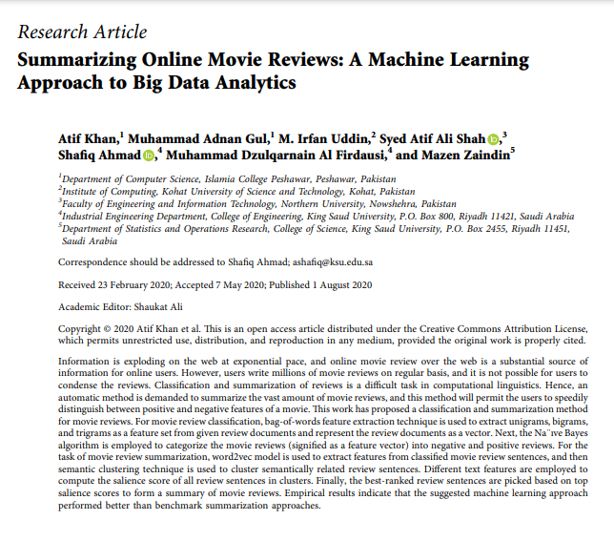
Final Research Paper

Slide 11
Methodology
Data Collection
Preprocessing
Feature Extraction
Classification
Review summarization
Kaggle
Data Mining
NLP
Machine Learning
NLP
Open-Source
NLP
Machine Learning

Slide 12
Preprocessing - Extraction of context from text
Sentence Segmentation
Tokenization
Stop Words Removal
Stemming
Lemmatization

Slide 13
Feature Extraction
Bag of words
Unigrams
Bi-grams
Tri-grams

Slide 14
Classification
Naive Bayes
Support Vector Machine
Decision Trees
Neural Networks

Slide 15
Review summarization
Graph based semantic representation for Sentence Embedding (word2vec)
Relevancy score
Eigen Vector
Cosine Similarity
Adjacency Matrix
Clustering Of Semantically Similar Sentences
Text Features Extraction
Selection Of Top Relevant Sentences From Clusters
Movie Summary Generation from k - top sentences

Slide 16
Project Implementation

Slide 17
Implementation – Dataset
Kaggle Dataset
Own Dataset
Women Clothing
Data collection
Web Crawling
Amazon Food Reviews
Data labeling

Slide 18
Implementation – Dataset & Model
1
Data Collection
Web Crawling
2
Data labeling
3
Model Selection
4
Model Training
Pre-trained Model

Slide 19
Implementation – Dataset & Model
Pre-trained Model
Openai – GPT3.5
Openai Developer API Key
Model availability in python

Slide 20
Implementation – Dataset & Model
Testing Data
Web Crawling
Daraz
Extracted data

Slide 21
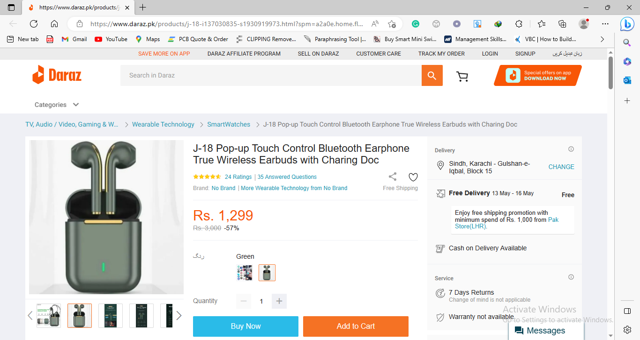
Implementation – Web Crawling
Random Browsing
9 Reviews
Manual Analysis

Slide 22
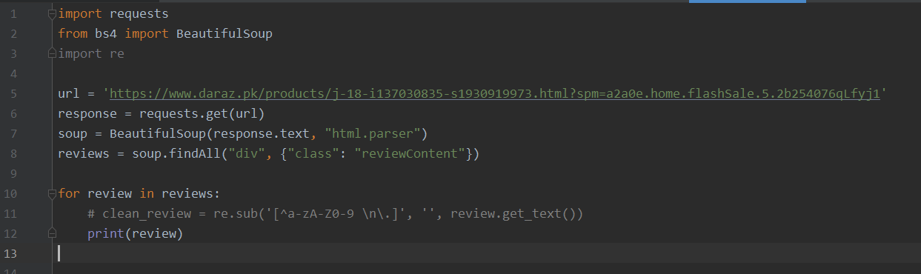
Implementation – Web Crawling

Slide 23
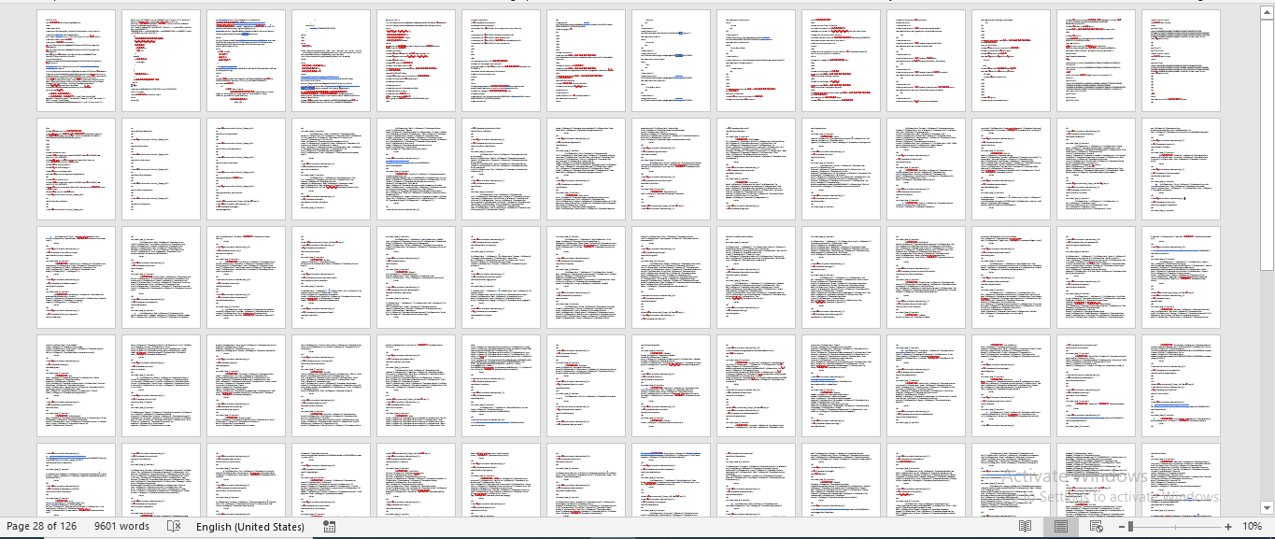
Implementation – Web Crawling
1 web page = 126 pages

Slide 24
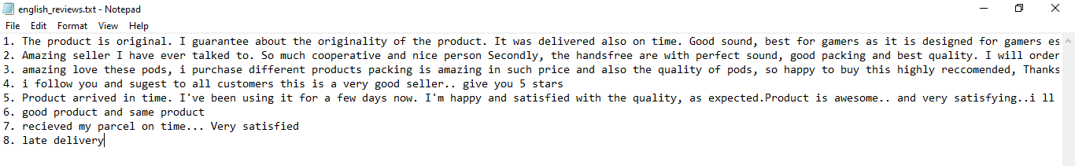
Implementation – Web Crawling

Slide 25
Implementation Pipeline
Openai
Text-davinci-002
Openai Summary
Access Openai API
Input Reviews
Openai Model
Sentiment Analysis
Summary Generation
Web Crawling
Sentiment Summary

Slide 26
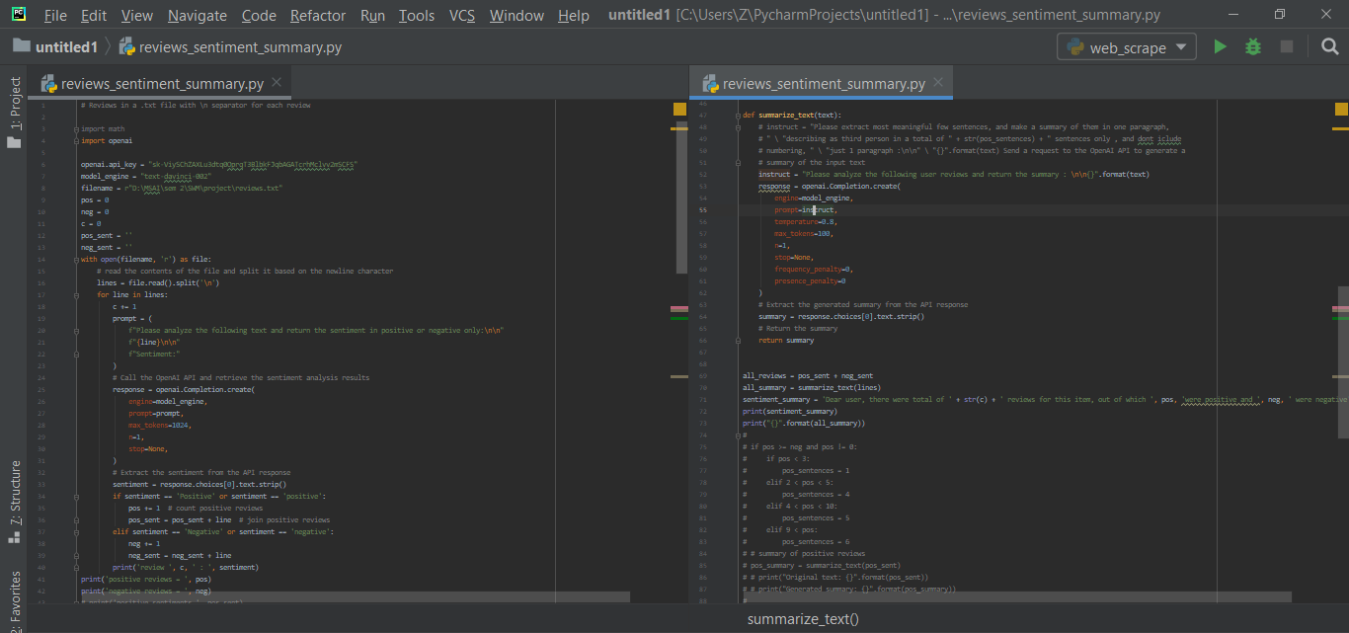
Implementation – Script Output

Slide 27
Implementation
Sentiment Analysis Output
review 1 : Positive
review 2 : Positive
review 3 : Positive
review 4 : Positive
review 5 : positive
review 6 : positive
review 7 : Positive
review 8 : Negative

Slide 28
Implementation
Dear user, there were total of 8 reviews, out of which 7 were positive and 1 was negative.
Summary from Sentiment Analysis

Slide 29
Implementation
Majority of reviews are positive, with customers praising the quality of the product, the sound, the packing, the price, and the seller. There are a few complaints about delivery, but mostly customers are happy with their purchase.
Openai Summary

Slide 30
Implementation
Dear user, there were total of 8 reviews, out of which 7 were positive and 1 was negative
Majority of reviews are positive, with customers praising the quality of the product, the sound, the packing, the price, and the seller. There are a few complaints about delivery, but mostly customers are happy with their purchase.
Overall Summary

Slide 31
Discussions and Conclusion
Dataset + Model = Pre-trained Model, if satisfies requirements
Web Crawling – easily doable
Sentiment analysis for count summary
Openai based Summary generate
Merged both summaries

Slide 32
References
Khan, A., Gul, M. A., Uddin, M. I., Ali Shah, S. A., Ahmad, S., Al Firdausi, M. D., & Zaindin, M. (2020). Summarizing online movie reviews: a machine learning approach to big data analytics. Scientific Programming, 2020, 1-14.
Pradeep, T., Sai Shibi, M. R., Manikandan, P., Hameed, M. S., & Arockia Xavier Annie, R. (2020). Summarization of User Reviews on E-Commerce Websites Using Hidden Markov Model. In Proceeding of the International Conference on Computer Networks, Big Data and IoT (ICCBI-2018) (pp. 470-482). Springer International Publishing.
Hanni, A. R., Patil, M. M., & Patil, P. M. (2016, September). Summarization of customer reviews for a product on a website using natural language processing. In 2016 International conference on advances in computing, communications and informatics (ICACCI) (pp. 2280-2285). IEEE.
Bafna, K., & Toshniwal, D. (2013). Feature based summarization of customers’ reviews of online products. Procedia Computer Science, 22, 142-151.

Slide 33
Thank You, Questions ?

